Slide 1

Experimental Design Final Project
Graham Bachman

Slide 2
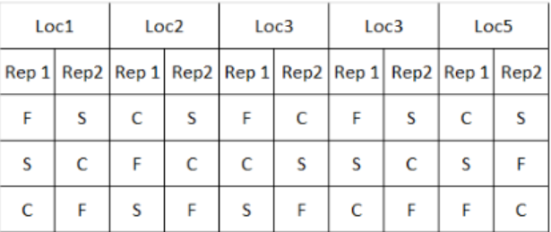
The experiment
Tom Newell, a plant scientist at Bayer CropSciense, in 2019 conducted a study to investigate if:
The new fertilizer would have a more significant impact on yield than the current product (C)?
The new fertilizer has two formulas: slow release (S) and fast release (F). Tom wanted to investigate if:
The new products (two formulas) and the current product performed similar across fields
There would be a significant difference between S and F on yield impact?
There would be a significant difference between S and C on yield impact?
There would be a significant difference between F and C on yield impact?
The experiment was conducted using one wheat product, and tested in 5 locations, 2 Reps per location; on each testing plot, yield (Y) was recorded along with plant height (X).

Slide 3
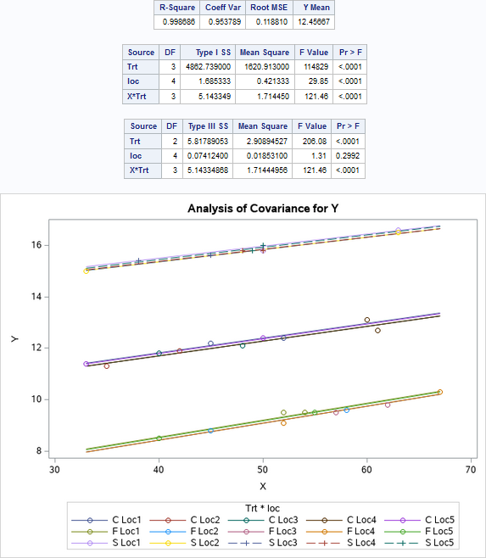
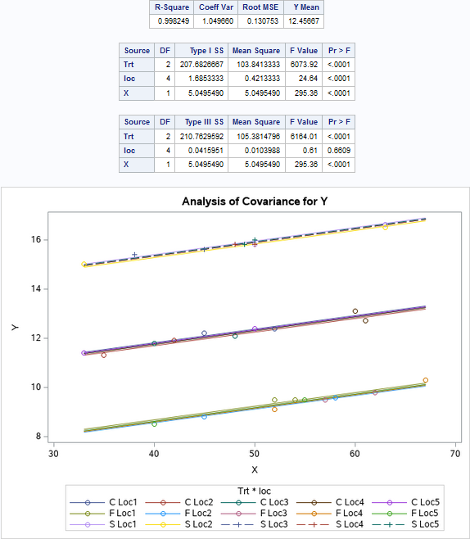
Significance of covariate - Plant height
Homogeneous – Covariate is significant
Heterogeneous – Covariate is significant
Shows strong linear relationship between yield and plant height

Slide 4
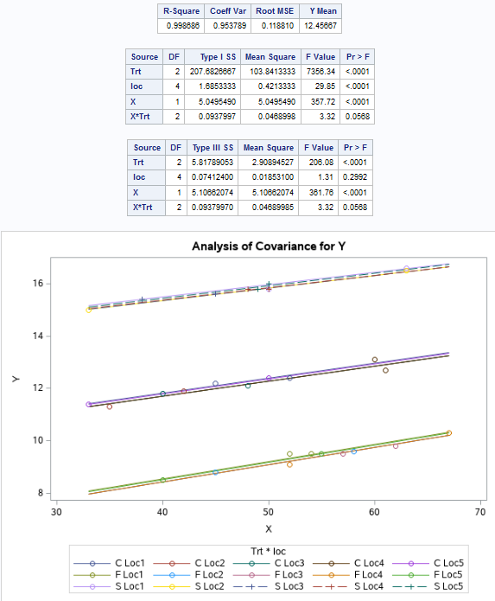
Common Slope
Model explains 0.998686 of the variation in yield – it is a good model.
Our test is not quite significant, P-Value = 0.0568
Since our test is not significant, we should proceed with running ANCOVA.

Slide 5
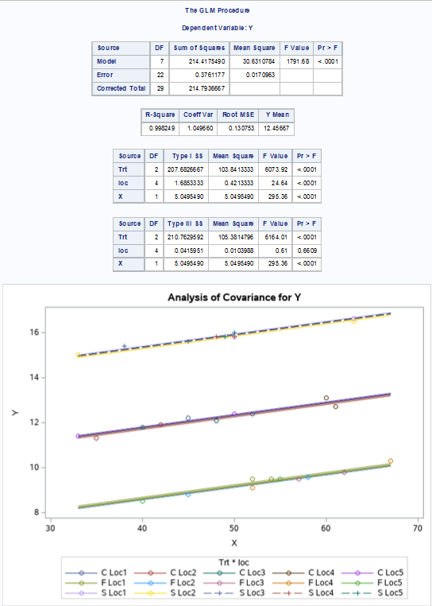
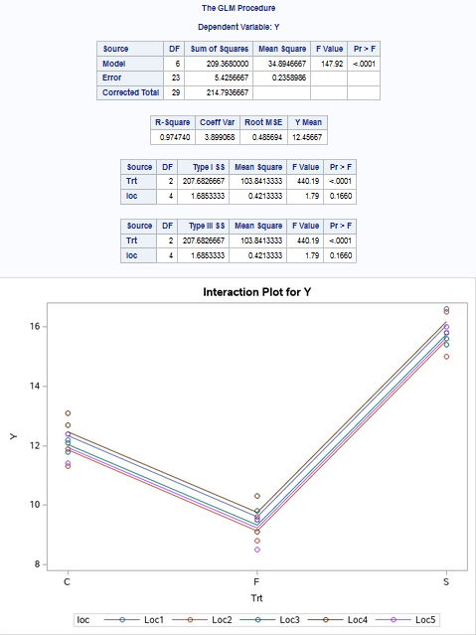


GLM Comparison
ANCOVA
ANOVA

Slide 6
Comparison Continued
- While both ANCOVA (R-Squared 0.9982) and ANOVA (R-Squared 0.9747) are good models that can explain most of the variance in yield, by including the continuous factor plant height, the ANCOVA model is able to better explain the variance in yield.
- By using ANCOVA, we were able to capture another dimension of complexity in our experiment that ANOVA misses altogether. ANCOVA shows that there is a clear linear relationship between plant height and yield that ANOVA is blind to.
- While the final calculations are different, our conclusions about which factors are significant are the same in both cases (except for plant height in ANCOVA, since that was not considered in the ANOVA procedure).
- While we may be tempted to suppose that fertilizer formula does not make a significant difference, both models affirm the significance of the Trt factor. ANCOVA only gives a more complete picture, because it can attribute variance to plant height where ANOVA must explain that variance in terms of location.

Slide 7
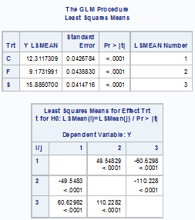
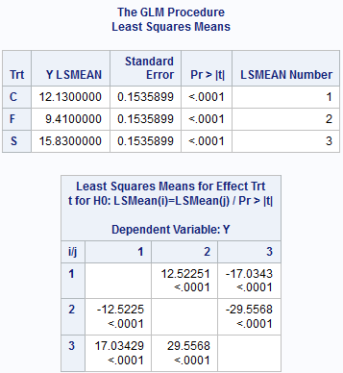
Least Square means comparison
ANCOVA
ANOVA

Slide 8
Conclusions
We draw the following conclusions from this experiment:
Formulas F, S and C all differ significantly from each other in their effect on yield.
Formula F and S are similar to formula C across fields. They behave congruently; however, the yield is significantly higher under formula S, and significantly lower under formula F.
Both formula and plant height are statistically significant factors. Therefore, ANCOVA is the preferred choice because by incorporating the plant height factor we can dramatically reduce our model’s error (the model is about 0.11 more accurate under ANCOVA).

